Slide 1
Preliminaries: Past, Architectures, Pre-training, Capabilities
AntNLP 2022 Fall Seminar
Li Yuqian
Notes:
Welcome to … .
My name is …

Slide 2
主要内容
什么是Language model
Transformer
Bert
OpenAI GPT
RoBERTa
ELECTRA

Slide 3
主要内容
什么是Language model
Transformer
Bert
OpenAI GPT
RoBERTa
ELECTRA

Slide 4
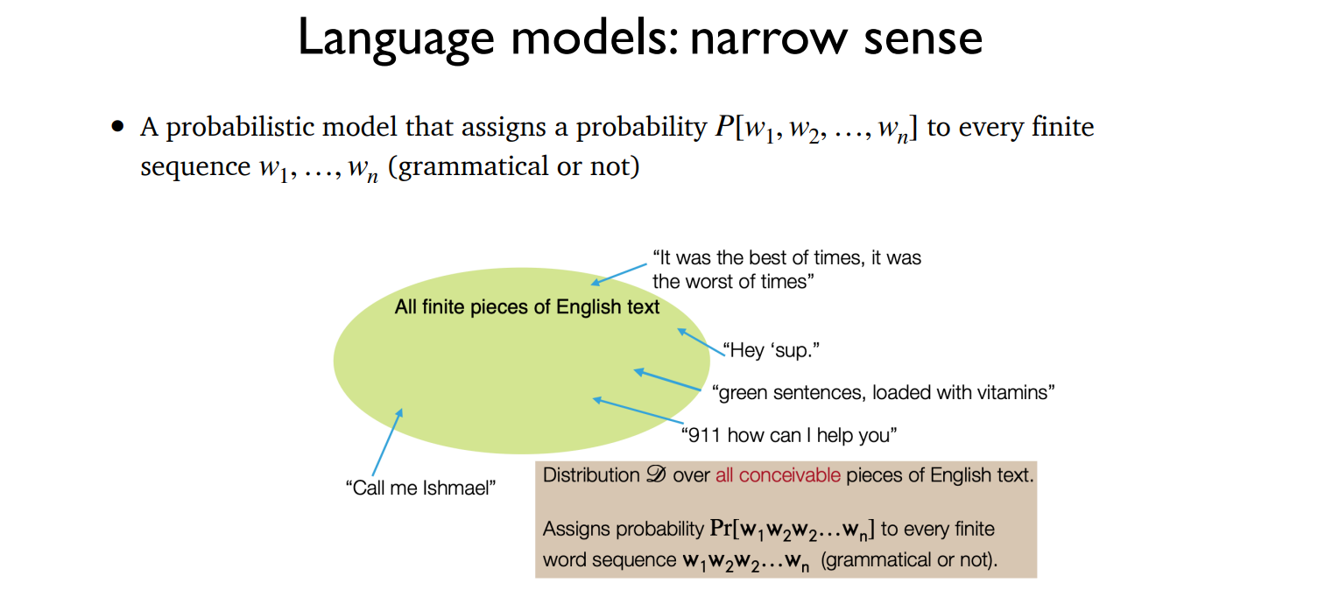

Slide 5
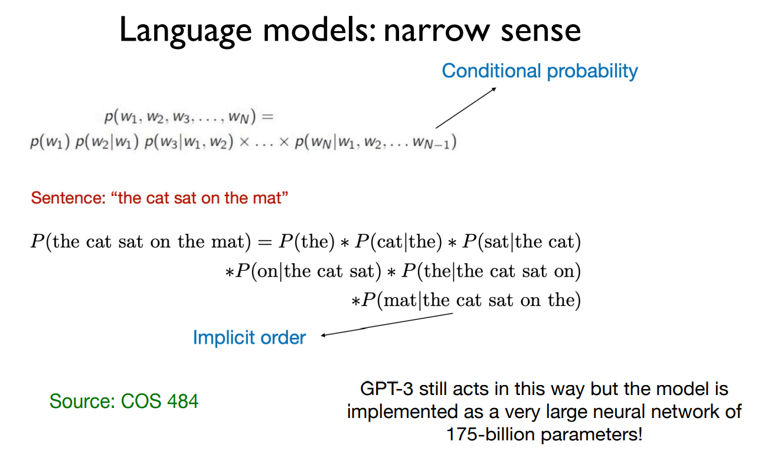
语料库：
The cat sat…
The cat eat…
The mouse sat…
On the mat…
Sat on…
Sat beside…

Slide 6
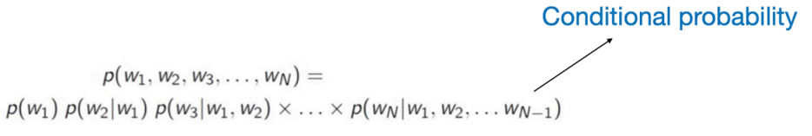
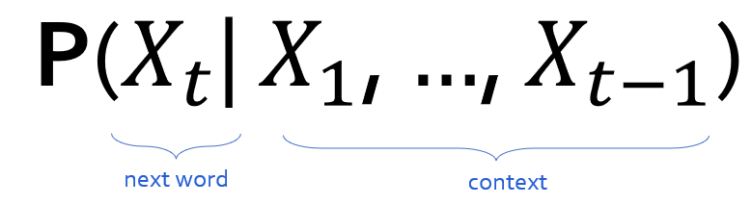
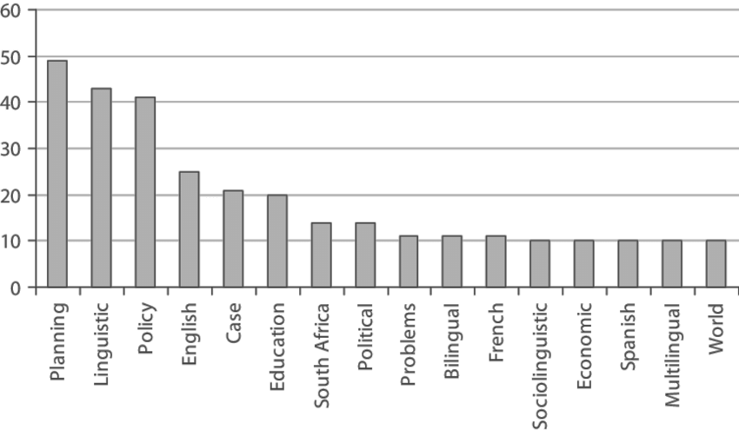
Language models的另一种定义
如果能计算条件概率，就能得到整体的概率，因此从文本生成的角度看，语言模型也可以被定义为：
Prob
Some model
mat
table
bed
desk
chair
“The cat sat on the [MASK]”

Slide 7
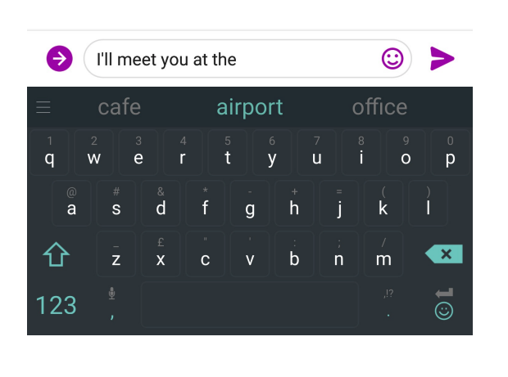
You Use Language Model Every day!

Slide 8

You Use Language Model Every day!

Slide 9
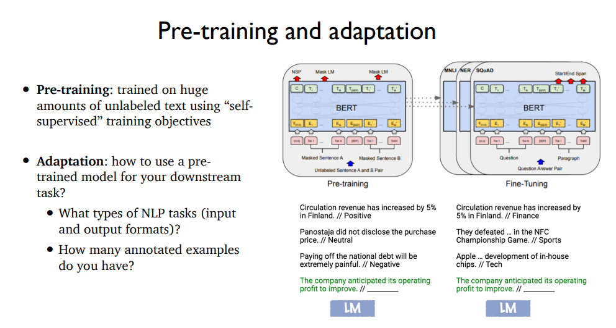
Notes:
现在假设用神经网络搭建好了一个语言模型，首先需要预训练，让这个模型学习到语料库的词序列分布；然后要学会把这个模型通过一些方法应用到下游任务，比如机器翻译、词性标注、文本生成、文本分类等

Slide 11
Supervision vs Self-supervision vs Un-supervision
Supervision有标注数据，例如文本情感分类任务中，给一段文本打上positive或negative的标签。
Self-supervision的数据不是人工标注的，而是通过辅助任务在大规模无标注数据中自动构造监督信息，通过得到的标签就可以类似supervision进行学习，典型的就是language model。
Un-supervision无标注数据，通常利用聚类找到样本间的关系。

Slide 12

Pre-training: self-supervision
== lemon
The lemon (Citrus limon) is a species of small evergreen trees in the flowering plant family Rutaceae, native to Asia, primarily Northeast India (Assam), Northern Myanmar or China.[2] The tree's ellipsoidal yellow fruit is used for culinary and non-culinary purposes throughout the world, primarily for its juice, which has both culinary and cleaning uses.[2] The pulp and rind are also used in cooking and baking. The juice of the lemon is about 5% to 6% citric acid, with a pH .…
== wheelbarrow
A wheelbarrow is a small hand-propelled vehicle, usually with just one wheel, designed to be pushed and guided by a single person using two handles at the rear, or by a sail to push the ancient wheelbarrow by wind. The term "wheelbarrow" is made of two words: "wheel" and "barrow." "Barrow" is a derivation of the Old English "barew" which was a device used for carrying loads. The wheelbarrow is designed to distribute the weight of its load between the wheel …
== wings over kansas wings over kansas is the second studio album by jason ammons, john bolster and mo rosato. the album debuted at number one on the billboard 200, selling 35,000 copies in it first week at the time. it was the second highest selling album to debut at the billboard top 50 and the third highest selling album to debut at the top heatseekers, with 26,000 copies sold. this is the supremes album earning the nickname nitty gritty but their other two singles by the band in …
== treaty of paris (1763) the treaty of paris, also known as the treaty of 1763, was signed on 10 february 1763 by the kingdoms of great britain, france and spain, with portugal in agreement, after great britain's victory over france and spain during the seven years' war. the signing of the treaty formally ended the seven years' war, known as the french and indian war in the north american theatre, ….
Dataset of Wikipedia articles
[Slide from Colin Raffel]
Notes:
通过自监督学习到特征分布
we can train a generative model to generate new Wikipedia articles.
In this example. the generated article discusses a made-up album called Wings over Kansas.
The model was only given the title of the article and filled in the rest.
You can see that the model has learned not only basic sentence structure, grammar, and spelling, but also the kind of content which is typical in Wikipedia articles.
It also stays on theme, though it does end up generating some nonsense near the end.

Slide 13
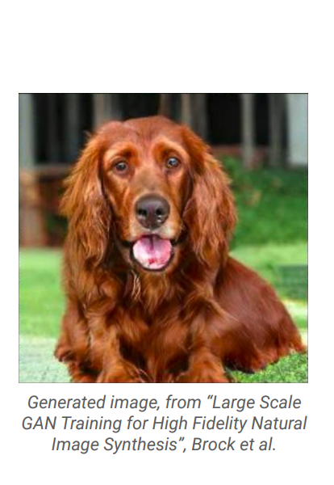
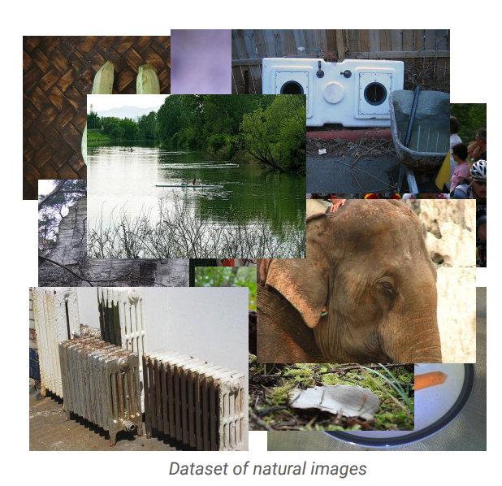
Pre-training: self-supervision
[Slide from Colin Raffel]
Notes:
Here's an example of an image produced by a recent generative model developed by some researchers at DeepMind.
The generative model has made up this dog completely on its own.
It has never seen this particular dog before in the training set, either.
To my eyes at least, it's hard to tell that this is a generated image and not a real picture of a dog.

Slide 15
Adaptation
Goal: Sentiment classification
Review: “While this restaurant is popular on Google, I absolutely disliked it.”
✍️
“We want to decide whether the sentiment of the review is "positive" or "negative".
Review: "While this restaurant is popular on Google, I absolutely disliked it".
The sentiment of this review is” [MASK]
“...is negative.”
Produced with GPT-J: https://6b.eleuther.ai/

Slide 16
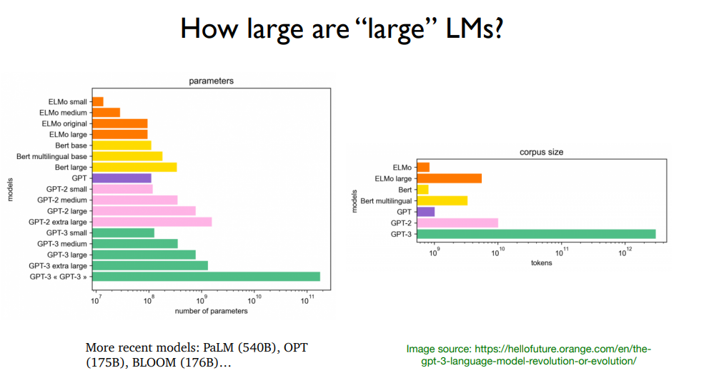

Slide 17
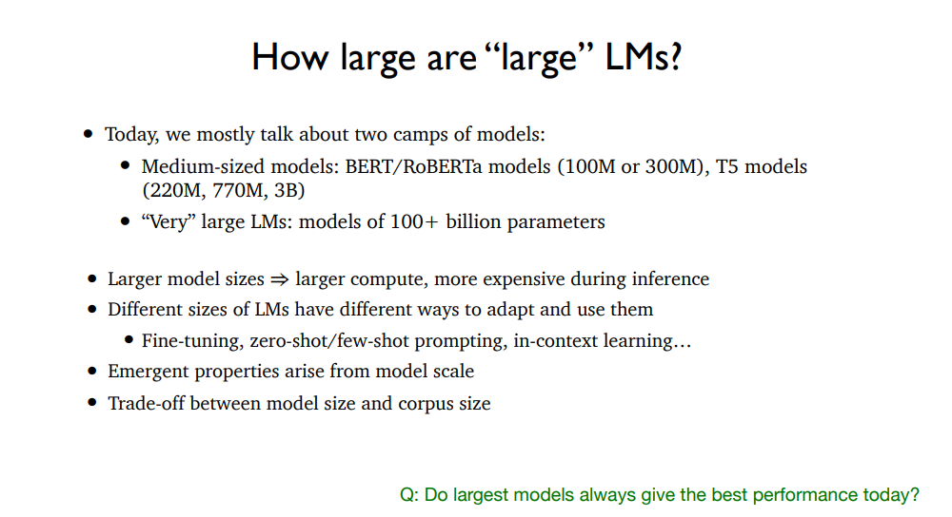

Slide 18
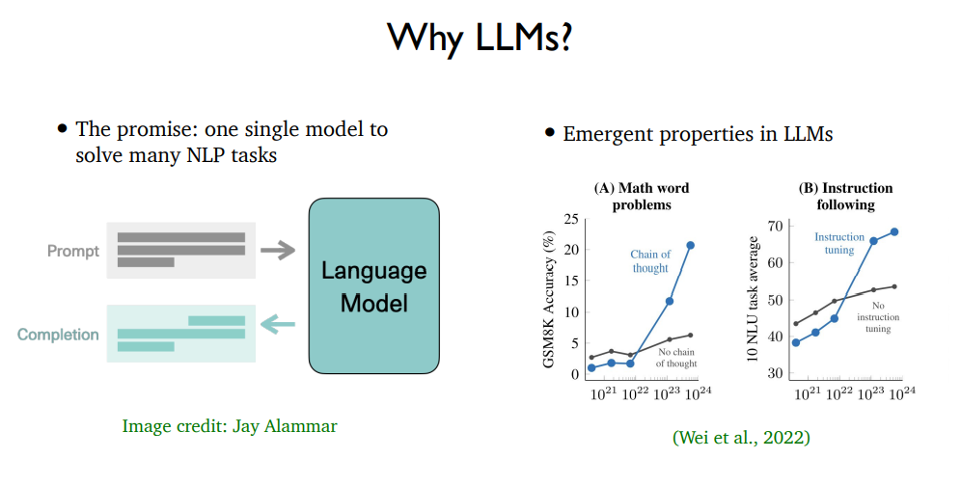
Notes:
涌现性。多个要素组成系统后、出现了系统组成前单个要素所不具有的性质。第一个图是思维链，它不再只预测答案，而是将思维过程也预测出来。第二个图是instruction-tuning，它的思想是：在对A做Prompt-tuning之前，先在其他若干的任务之上做Prompt-tuning。总的来说，它的意思就是语言模型是一个比较整体、综合性的预训练模型，它的训练数据涵盖范围广，能获得超出单个任务叠加的效益。

Slide 19
Language models的一些问题
AI公平，涉及种族歧视、性别偏见等
编造危害性内容，比如谣言等

Slide 20
主要内容
什么是Language model
Transformer
Bert
OpenAI GPT
RoBERTa
ELECTRA

Slide 21
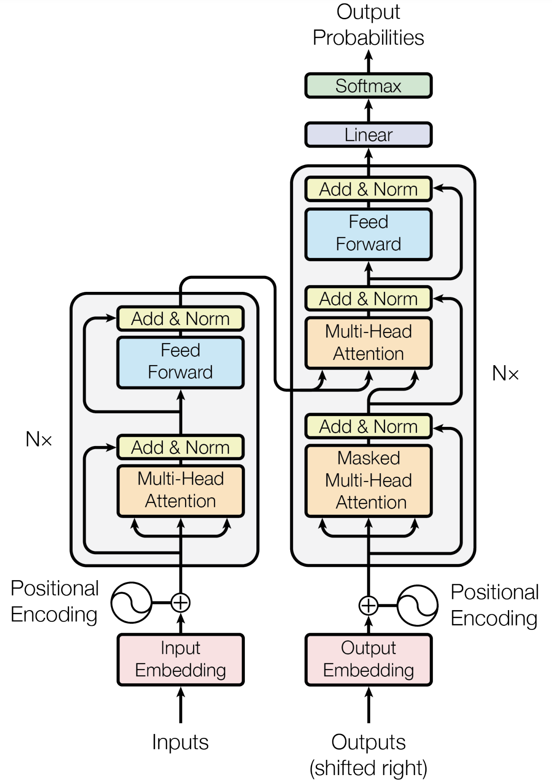
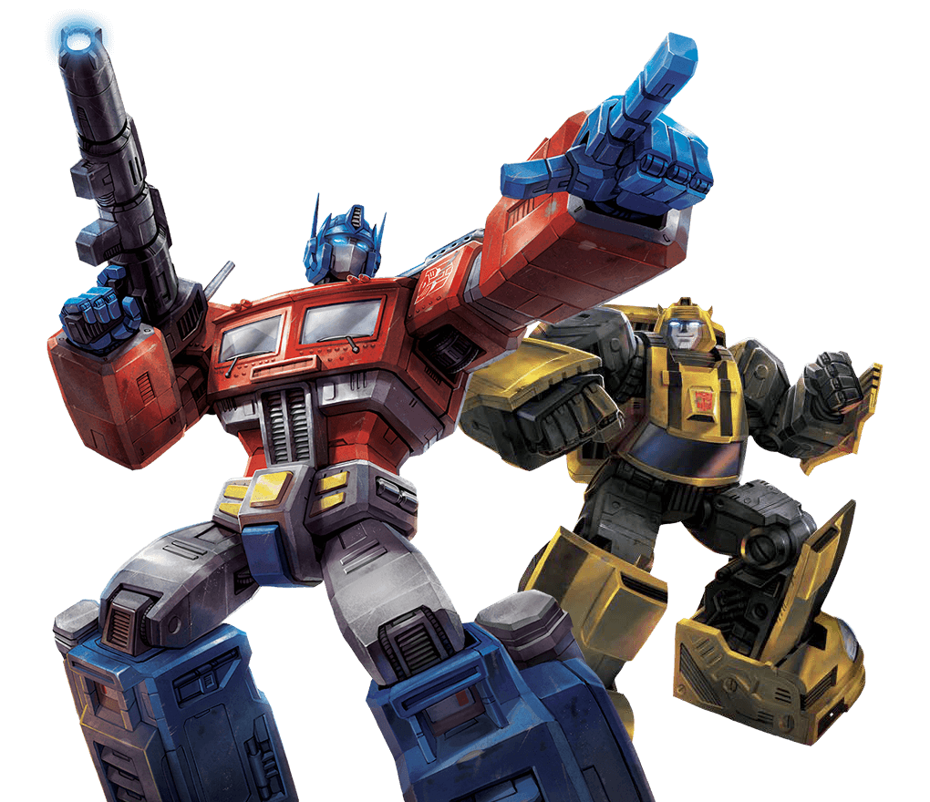
Transformer [Vaswani et al. 2017]
An encoder-decoder architecture built with attention modules.
Sequence-to-sequence

Slide 22
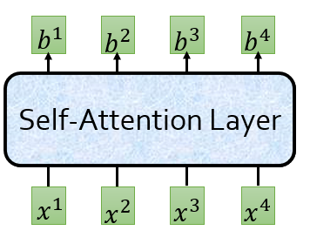
Self-Attention
表示出每个词与其它词之间的依赖关系，或者说其它词对该词的影响程度

Slide 23
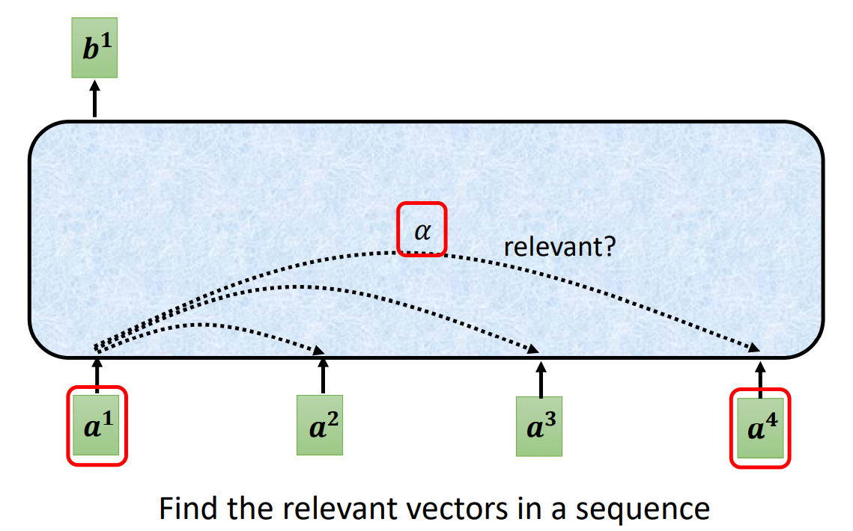
Self-Attention

Slide 24
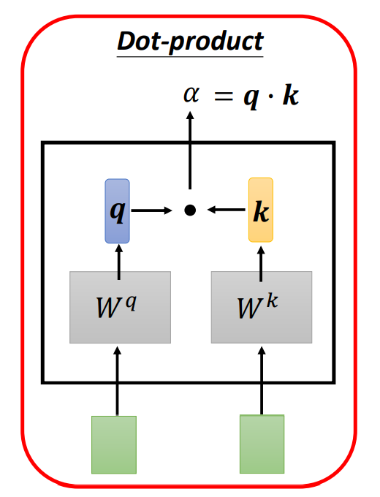
Self-Attention：计算两个向量之间的关联性

Slide 25
Defining Self-Attention
Terminology:
Query: to match others
Key: to be matched
Value: information to be extracted
Definition: Given a set of vector values, and a vector query, attention is a technique to compute a weighted sum of the value, dependent on the query.
[Vaswani et al. 2017: https://arxiv.org/abs/1706.03762]

Slide 26
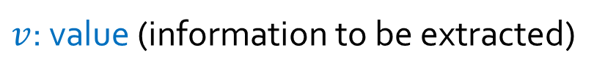
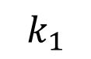
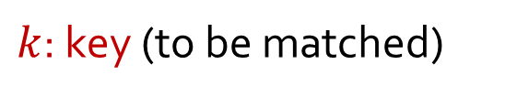
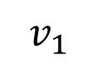
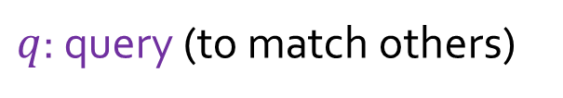
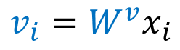
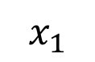
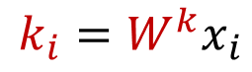
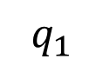
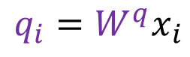
$q$: query (to match others)
$$q_{i}=W^{q}x_{i}$$
$k$: key (to be matched)
$$k_{i}=W^{k}x_{i}$$
$v$: value (information to be extracted)
$$v_{i}=W^{v}x_{i}$$
$$q_{1}$$
$$k_{1}$$
$$v_{1}$$
O O
O O
O O
O O O O O
$$x_{1}$$
The

Slide 27
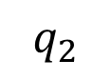
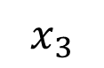
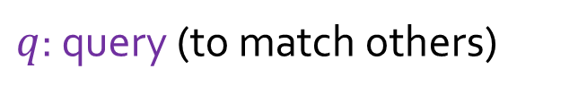
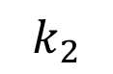
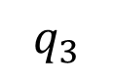
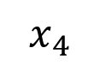
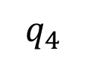
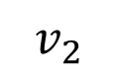
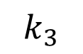
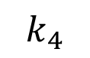
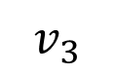
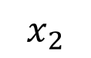
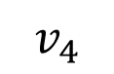
$q$: query (to match others)
$$q_{i}=W^{q}x_{i}$$
$k$: key (to be matched)
$$k_{i}=W^{k}x_{i}$$
$v$: value (information to be extracted)
$$v_{i}=W^{v}x_{i}$$
$$q_{1}$$
$$k_{1}$$
$$v_{1}$$
$$q_{2}$$
$$k_{2}$$
$$v_{2}$$
$$q_{3}$$
$$k_{3}$$
$$v_{3}$$
$$q_{4}$$
$$k_{4}$$
$$v_{4}$$
O O
O O
O O
O O
O O
O O
O O
O O
O O
O O
O O
O O
O O O O O
O O O O O
O O O O O
O O O O O
$$x_{1}$$
$$x_{2}$$
$$x_{3}$$
$$x_{4}$$
The cat sat on

Slide 28
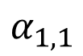
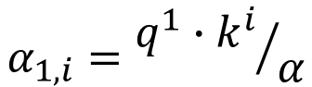
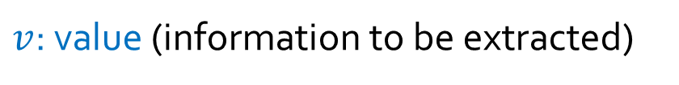
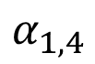
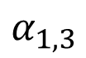

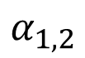
$q$: query (to match others)
$$α_{1,i}={q^{1}∙k^{i}}/α$$
$k$: key (to be matched)
$v$: value (information to be extracted)
Scaled dot product
How much should “The” attend to other positions?
$$α_{1,1}$$
$$α_{1,2}$$
$$α_{1,3}$$
$$α_{1,4}$$
$$q_{1}$$
$$k_{1}$$
$$v_{1}$$
$$q_{2}$$
$$k_{2}$$
$$v_{2}$$
$$q_{3}$$
$$k_{3}$$
$$v_{3}$$
$$q_{4}$$
$$k_{4}$$
$$v_{4}$$
O O
O O
O O
O O
O O
O O
O O
O O
O O
O O
O O
O O
O O O O O
O O O O O
O O O O O
O O O O O
$$x_{1}$$
$$x_{2}$$
$$x_{3}$$
$$x_{4}$$
The cat sat on

Slide 29
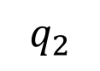
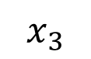
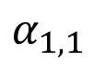
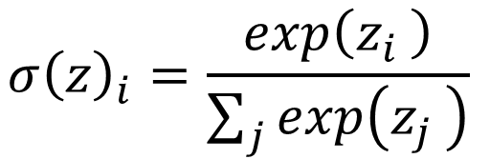





















$$σ{\left(z\right)}_{i}=\frac{exp\left(z_{i} \right)}{\sum_{j}{exp\left(z_{j} \right)}}$$
$${\hat{α}}_{1,1}$$
$${\hat{α}}_{1,2}$$
$${\hat{α}}_{1,3}$$
$${\hat{α}}_{1,4}$$
How much should “The” attend to other positions?
Softmax
$$α_{1,1}$$
$$α_{1,2}$$
$$α_{1,3}$$
$$α_{1,4}$$
$$q_{1}$$
$$k_{1}$$
$$v_{1}$$
$$q_{2}$$
$$k_{2}$$
$$v_{2}$$
$$q_{3}$$
$$k_{3}$$
$$v_{3}$$
$$q_{4}$$
$$k_{4}$$
$$v_{4}$$
O O
O O
O O
O O
O O
O O
O O
O O
O O
O O
O O
O O
O O O O O
O O O O O
O O O O O
O O O O O
$$x_{1}$$
$$x_{2}$$
$$x_{3}$$
$$x_{4}$$
The cat sat on

Slide 30

























$$b^{1}=\sum_{i}{{\hat{α}}_{1,i}v^{i} }$$
O O
Representation of “The” given the attention weights
$${\hat{α}}_{1,1}$$
$${\hat{α}}_{1,2}$$
$${\hat{α}}_{1,3}$$
$${\hat{α}}_{1,4}$$
Softmax
$$α_{1,1}$$
$$α_{1,2}$$
$$α_{1,3}$$
$$α_{1,4}$$
$$q_{1}$$
$$k_{1}$$
$$v_{1}$$
$$q_{2}$$
$$k_{2}$$
$$v_{2}$$
$$q_{3}$$
$$k_{3}$$
$$v_{3}$$
$$q_{4}$$
$$k_{4}$$
$$v_{4}$$
O O
O O
O O
O O
O O
O O
O O
O O
O O
O O
O O
O O
O O O O O
O O O O O
O O O O O
O O O O O
$$x_{1}$$
$$x_{2}$$
$$x_{3}$$
$$x_{4}$$
The cat sat on

Slide 31
$$b^{1}=\sum_{i}{{\hat{α}}_{1,i}v^{i} }$$
O O
One issue: the model doesn’t know word positions/ordering.
$${\hat{α}}_{1,1}$$
$${\hat{α}}_{1,2}$$
$${\hat{α}}_{1,3}$$
$${\hat{α}}_{1,4}$$
Softmax
$$α_{1,1}$$
$$α_{1,2}$$
$$α_{1,3}$$
$$α_{1,4}$$
$$q_{1}$$
$$k_{1}$$
$$v_{1}$$
$$q_{2}$$
$$k_{2}$$
$$v_{2}$$
$$q_{3}$$
$$k_{3}$$
$$v_{3}$$
$$q_{4}$$
$$k_{4}$$
$$v_{4}$$
O O
O O
O O
O O
O O
O O
O O
O O
O O
O O
O O
O O
O O O O O
O O O O O
O O O O O
O O O O O
$$x_{1}$$
$$x_{2}$$
$$x_{3}$$
$$x_{4}$$
The cat sat on
Notes:
Since self-attention doesn’t build in order information, we need to encode the order of the sentence in our keys, queries, and values.

Slide 32










$$b^{1}=\sum_{i}{{\hat{α}}_{1,i}v^{i} }$$
O O
One issue: the model doesn’t know word positions/ordering.
$p_{i}$ are unique fixed vectors (sinusoidal functions of varying periods).
$${\hat{α}}_{1,1}$$
$${\hat{α}}_{1,2}$$
$${\hat{α}}_{1,3}$$
$${\hat{α}}_{1,4}$$
Softmax
$$α_{1,1}$$
$$α_{1,2}$$
$$α_{1,3}$$
$$α_{1,4}$$
$$q_{1}$$
$$k_{1}$$
$$v_{1}$$
$$q_{2}$$
$$k_{2}$$
$$v_{2}$$
$$q_{3}$$
$$k_{3}$$
$$v_{3}$$
$$q_{4}$$
$$k_{4}$$
$$v_{4}$$
O O
O O
O O
O O
O O
O O
O O
O O
O O
O O
O O
O O
O O O O O
O O O O O
O O O O O
O O O O O
$$p_{1}$$
$$p_{2}$$
$$p_{3}$$
$$p_{4}$$
O O O O O
O O O O O
O O O O O
O O O O O
$$x_{1}$$
$$x_{2}$$
$$x_{3}$$
$$x_{4}$$
Notes:
And with that, we’re done with the definition of attention. Almost a complete definition.
If you followed everything, that’s awesome!
If you did not, that’s okay too. There’s a lot to life than ”attention” ….

Slide 33


矩阵计算

Slide 34

矩阵计算

Slide 35


矩阵计算

Slide 36

矩阵计算

Slide 37


矩阵计算

Slide 38










Self-Attention: Back to Big Picture
Attention is a way to focus on particular parts of the input
Can write it in matrix form:
Efficient implementations
Better at maintaining long-distance dependances in the context.
$$b^{1}$$
$$b^{2}$$
$$b^{3}$$
$$b^{4}$$
$$b=softmax\left(\frac{{QK}^{T}}{α}\right)V$$
Self-Attention Layer
$$x^{1}$$
$$x^{2}$$
$$x^{3}$$
$$x^{4}$$

Slide 39






Multi-Headed Self-Attention
Multiple parallel attention layers is quite common.
Each attention layer has its own parameters.
Self-Attention Layer
Self-Attention Layer
$$x^{1}$$
$$x^{2}$$
$$x^{3}$$
$$x^{4}$$
[Vaswani et al. 2017]

Slide 40


How Do We Make it Deep?
Add a feed-forward network on top it to add more capacity/expressivity.
Repeat!
O O
O O
O O
Feedforward Net: Refresher
Feed Forward Network
Multi-Headed Self-Attention Layer
A fully-connected network of nodes and weights.
O O
O O
O O

Slide 41
Encoder-Decoder Architectures
It is useful to think of generative models as two sub-models.
Some model
“The cat sat on the [MASK]”

Slide 42
Encoder-Decoder Architectures
It is useful to think of generative models as two sub-models.
Representation (compression) of the context
Encoder
Decoder
“The cat sat on the [MASK]”
Processes the context and compiles it into a vector.
Produces the output sequence item by item using the representation of the context.

Slide 43

Encoder-Decoder Architectures
https://jalammar.github.io/visualizing-neural-machine-translation-mechanics-of-seq2seq-models-with-attention/

Slide 44

Encoder

Slide 45

Encoder

Slide 46


Slide 47

Decoder(AT)

Slide 49
Masked Attention
b3
a1
a2
a3
a4

Slide 50

Cross Attention

Slide 51

Transformer [Vaswani et al. 2017]
An encoder-decoder architecture built with attention modules.
3 forms of attention

Slide 52

满足了Language model的需求
支持输入序列长度不一，因为参数量与序列长度无关
支持考虑全局信息，因为attention机制可以计算每个词之间的关注度
与RNN相比，解决了long-dependency的问题
与RNN相比，支持并行计算

Slide 53

训练和生成之间有差别
Decoder的输入不同：真实vs生成
评价生成序列的标准不同：交叉熵损失vs对于句子整体的评价
Notes:
scheduled sampling，以一定概率将生成的元素作为解码器输入

Slide 54

Impact of Transformers
Let to better predictive models of language!
[”Efficient Content-Based Sparse Attention with Routing Transformers” Roy et al. 2020]

Slide 55


Impact of Transformers
A building block for a variety of LMs
Examples: BERT, RoBERTa, SciBERT.
Captures bidirectional context. Wait, how do we pretrain them?
Encoders
Examples: GPT-2, GPT-3, LaMDA
Other name: causal or auto-regressive language model
Nice to generate from; can’t condition on future words
Decoders
Encoder-
Decoders
Examples: Transformer, T5, Meena
What’s the best way to pretrain them?

Slide 56
主要内容
什么是Language model
Transformer
Bert
OpenAI GPT
RoBERTa
ELECTRA

Slide 57
Bert
2018年10月由Google AI提出的一种预训练模型，全称是Bidirectional Encoder Representation from Transformers
模型框架采用Transformer中的Encoder部分
在11个nlp任务上都取得了SOTA表现

Slide 58

Bert Pre-training
--Goal: Understanding features in representation space
--Trains model on unlabeled data over different pre-training tasks (Self-supervised learning)
Jacob, 2018. BERT: Pre-training of Deep Bidirectional Transformers for Language Understanding

Slide 59

Bert pre-training
Pre-training BERT:
Task #1: Masked Language Model(MLM)
Inputs: The [Mask1] Hopkins University is located in [Mask2] city (E)
Outputs: [Mask1] = Johns, [Mask2] = Baltimore (C, T)
=> Helps understand bi-directional context
Task #2: Next Sentence Prediction(NSP)
Inputs:
A: Johns Hopkins is a university (E)
B: It is located in Baltimore city (E)
Outputs:
Yes: Sentence B follows sentence A (C = 1)
=> Help understand context across different sentences
Jointly training by soft-max layer and cross-entropy
80% [MASK]
10% a random token
10% original token
15% masked
✍️: Ha, Isabel

Slide 60

Bert pre-training
Pre-training BERT:
Task #1: Masked Language Model(MLM)
Inputs: The [Mask1] Hopkins University is located in [Mask2] city (E)
Outputs: [Mask1] = Johns, [Mask2] = Baltimore (C, T)
=> Helps understand bi-directional context
Task #2: Next Sentence Prediction(NSP)
Inputs:
A: Johns Hopkins is a university (E)
B: It is located in Baltimore city (E)
Outputs:
Yes: Sentence B follows sentence A (C = 1)
=> Help understand context across different sentences
Jointly training by soft-max layer and cross-entropy
✍️: Ha, Isabel

Slide 61

Bert pre-training: putting together
Input Embeddings:
Token Embeddings: pre-trained token vocabs (“WordPleces”: 30K vocabs/tokens)
[CLS]: token beginning sentence, [SEP]: token ending sentence, [PAD]: padding token
Segment Embedding: sentence number encoder to vectors
Position Embedding: position of words within that sentence
=> Preserve ordering sentence inputs for BERT => Robust across downstream tasks
✍️: Ha, Isabel
Jacob, 2018. BERT: Pre-training of Deep Bidirectional Transformers for Language Understanding

Slide 62

Bert pre-training: putting together
Jacob, 2018. BERT: Pre-training of Deep Bidirectional Transformers for Language Understanding

Slide 63

Bert支持fine-tuning
Pre-training model应用到下游任务的方法有两种：

Slide 64

Fine-tuning Bert

Slide 65

Fine-tuning Bert

Slide 66

GLUE Results
GLUE是9种natural language understanding任务的集合
MNLI：句子对的蕴含分类任务
QQP：问题对是否等价的二元分类任务
QNLI：句子是否包含问题答案的二元分类任务
SST-2：电影评论的情绪分类任务
CoLA：单句是否可接受的二元分类任务
STS-B：句子对语义相似度的打分任务
MRPC：新闻句子对是否等价的二元分类任务
RTE：识别文本蕴含关系的分类任务
Jacob, 2018. BERT: Pre-training of Deep Bidirectional Transformers for Language Understanding
✍️: Ha, Isabel

Slide 67

SQuAD Results
斯坦福问答数据集
Given a question and a passage from Wikipedia containing the answer, the task is to predict the answer text span in the passage.

Slide 68


Ablation study: pre-training tasks

Slide 69

Ablation study: model sizes

Slide 70
主要内容
什么是Language model
Transformer
Bert
OpenAI GPT
RoBERTa
ELECTRA

Slide 71
GPT
2018年6月（比Bert早）由OpenAI提出，全称为Generative Pre-Training
 | GPT | Bert
模型框架 | Transformer中的Decoder | Transformer中的Encoder
编码方式 | Unidirectional | Bidirectional
训练方式 | Predict Next Token | MLM&NSP
适合任务 | 生成 | 理解
参数量 | 117M | 110M
如何应用于下游任务 | 都支持fine-tuning和featured-based

Slide 72
主要内容
什么是Language model
Transformer
Bert
OpenAI GPT
RoBERTa
ELECTRA

Slide 73
RoBERTa
2019年提出，基于对Bert超参数的研究，来自论文《A Robustly Optimized BERT Pretraining Approach》
训练模型时间更长，Batch Size更大，数据更多
删除Next Sentence Prediction
长序列训练
采用动态掩码，目的是学习到更多的表征
收集了一个新的大型数据集

Slide 74
主要内容
什么是Language model
Transformer
Bert
OpenAI GPT
RoBERTa
ELECTRA

Slide 75

ELECTRA
本质上是换了一种方式来训练bert模型的参数
主要是针对bert MLM中掩码15%导致的计算量巨大的问题
借助GAN思想

